Slide 1
Design and drawing for production
Unit 5 – Basic Geometry
Section 2 – Design Challenge 1

Slide 2
The big idea
Applying the design process
Safe, secure, affordable housing
Natural disaster response
Sustainability

Slide 3
Introduction
Safe, secure, affordable housing is needed in many parts of the country. In the wake
of a hurricane, tsunami, or forest fire, many affordable homes are needed quickly.
Shipping containers were originally invented to carry cargo across oceans.

Slide 4
Introduction
Cargo shipping containers make great housing because they are strong, durable, waterproof, resistant to mold, fire, and termites, as well as being affordable, easy to assemble, stackable, and readily available.
Shipping containers are in abundant supply and many are ready for recycling; housing is the ideal solution.

Slide 5
Constraints
In this problem you will design a one-story home from four or fewer reclaimed shipping containers using your knowledge from this unit.
Consider factors like room sizes and relationships, kitchen working triangle, and plumbing configurations.
The containers are 8’x20’ and must be made into a one-story, one-family, two-bedroom, and 1 or 1½ bathroom home

Slide 6
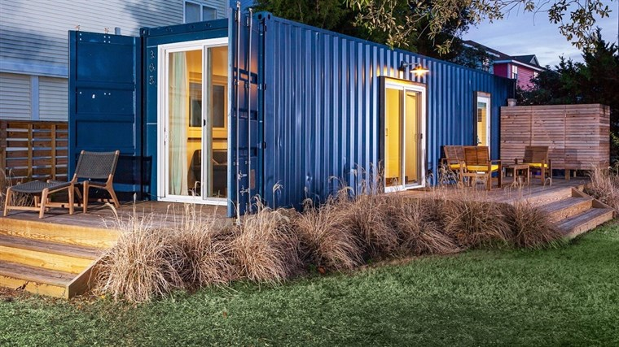

Slide 7
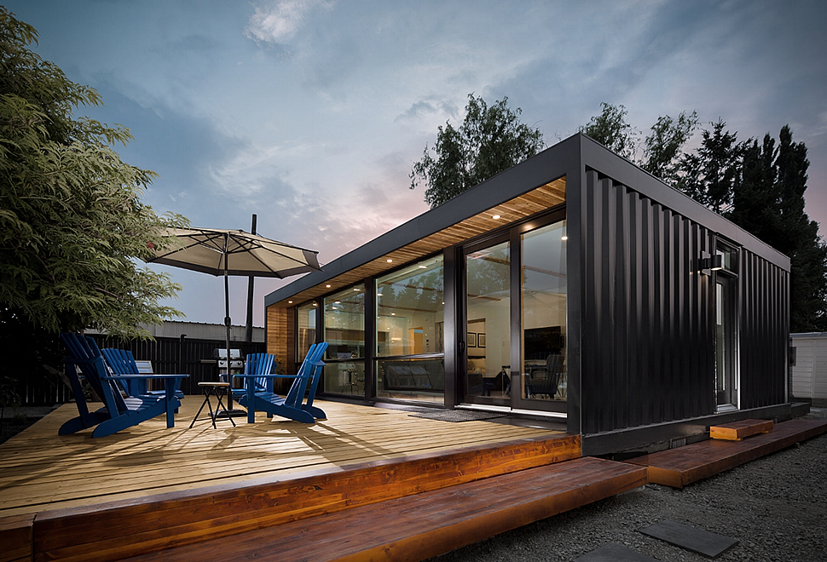

Slide 8
Group assignments
Groups will need to be organized into groups of 4
Assignments to be completed via Google Classroom are:
Shipping Container templates
4 preliminary rough sketches
More designs equal more points
Design statement document
Research document

Slide 9
4 Preliminary Rough sketches
Include Title Block
NAME | DDP | RS # | DATE | SCALE
Be sure to allocate Rough Sketch drawings between group members
Highly detailed rough sketches
Arrowheads pointing to important areas
Notes are lettered using a lettering guide where possible
Your groups portfolio / presentation should be started
Include images of sketches and designs
Include discussion or talking points your group had
Outline your groups design process

Slide 10
4 Preliminary Rough sketches
Include Title Block
NAME | DDP | RS # | DATE | SCALE
Be sure to allocate Rough Sketch drawings between group members
Highly detailed rough sketches
Arrowheads pointing to important areas
Notes are lettered using a lettering guide where possible
Each additional sketch is +100 points towards your total preliminary sketch grade
First 4 DUE FRIDAY 11/9

Slide 11
NEXt steps
4 Rough Designs now completed
Begin building group PRESENTATION PORTFOLIO
Title Page
Introduction (Design Statement)
Inspiration of your designs
Thought process (how you are problem solving this challenge)
4 Rough Sketch Designs (Be sure to talk about your designs)
Decision Matrix

